Slide 1
Media Hub
Martin Brnak

Slide 2
App Idea
Media Sharing app
Convenient Media Searching application
Seamless transition and exporting between applications
AI recognition for automatically tagging Media to further ease the use of the app
Possibility for expansion in the future:
Edit media
Expand the media available in the application

Slide 3
APIs
Google Cloud – Video AI
Giphy API
Instagram / TikTok API
OAuth

Slide 4
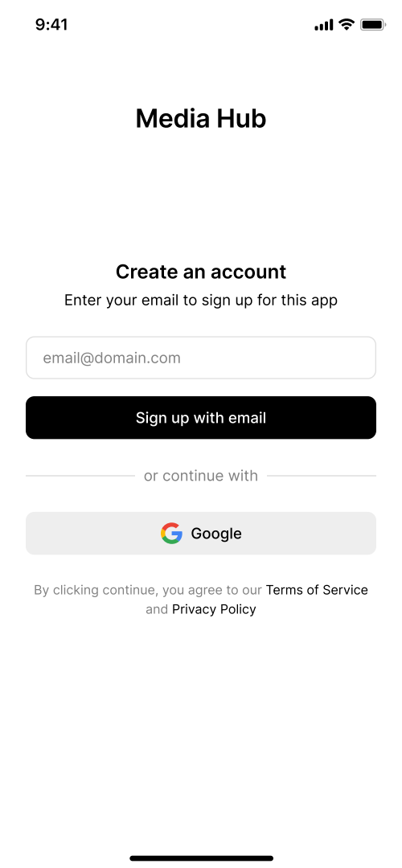
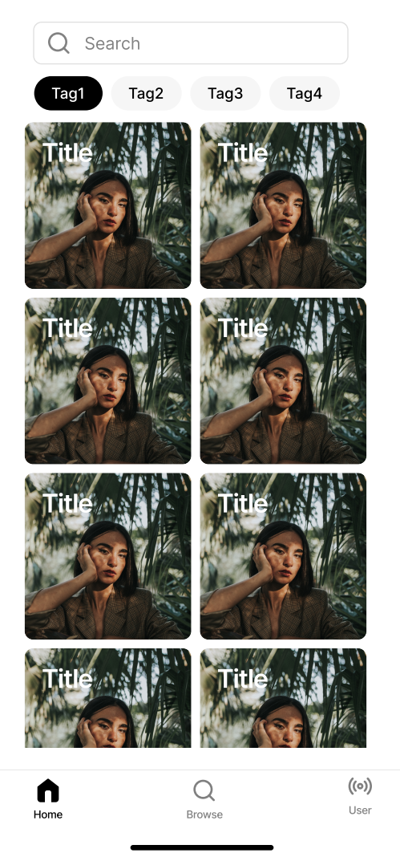
Wireframes / Storyboards
Main page:
Downloaded local media
Has tags and Search
Explore page
Giphy / other sources
Possible to search / sort
On first startup
Main page / Explore page

Slide 5
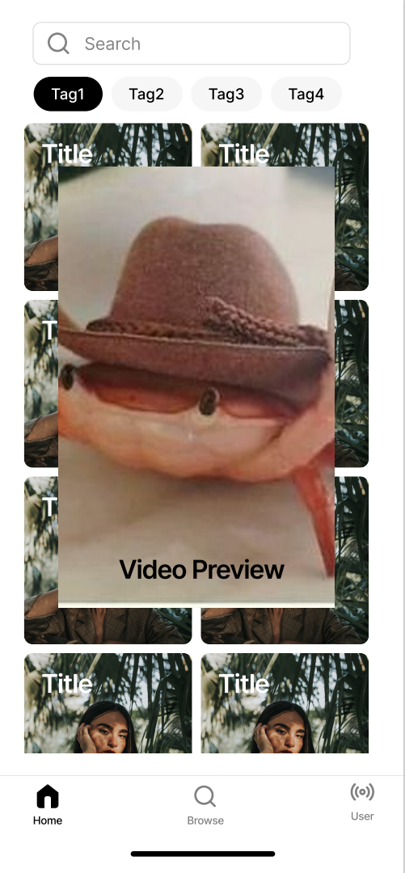
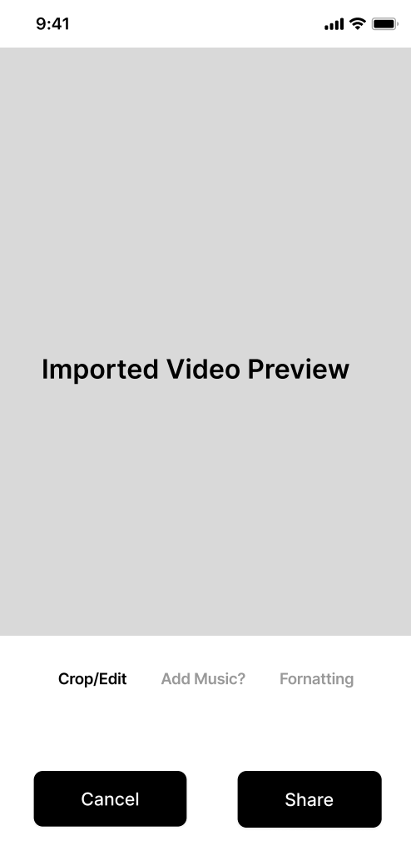
Wireframes / Storyboards
On Hover over media
(preview)
On click - share

Slide 6
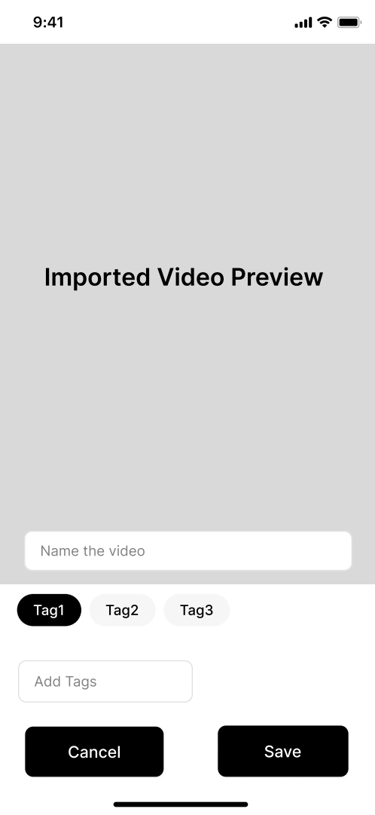
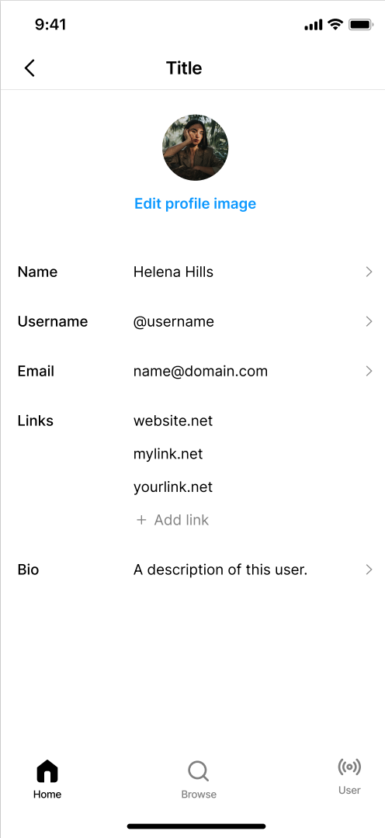
Wireframes / Storyboards
When a media is shared with the app
User page – not needed to be very detailed

